Slide 1
INF428 Final Project
Catherine Remy Duffield
001529006

Slide 2
Service Payment Call Predictor
Assignment Information
Cleaning up Data
Lessons Taught
Model Aptitude
Review

Slide 3
The Assignment
Background and information of the project

Slide 4
Project Call Predictor
This project aimed to create a Python model to predict the likelihood of policyholders with payments due to an insurance company making a service payment call. Identifying these policyholders will determine the best targets to send emails encouraging the use of automated payment channels instead. Data on customers with payment due in the next five days was provided. The primary tool to achieve the insurance company's endeavor was Python.

Slide 5
Data Cleaning
Preparing the data for use

Slide 6

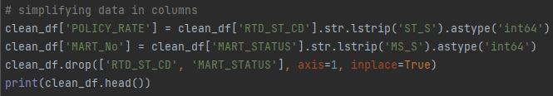
Steps to Clean Data
The data was assessed, and 0 was deemed an acceptable replacement for nulls. It can be assumed that the nulls represented accounts less than three months old.
Two columns of the data could be simplified to numbers by removing the characters preceding the numbers. These characters were identical throughout the columns, with only the numbers indicating differences.

Slide 7
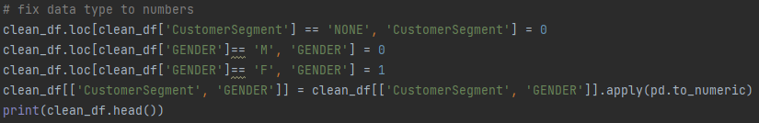
Continuing to Clean Data
The last two columns, still containing strings, were CustomerSegment and GENDER. These columns required different changes but with similar coding. For CustomerSegment, the only non-numerical entry was NONE, replaced by 0, which was unused in that column. GENDER was smoothly changed to a binary with male, represented by M, equaling 0, and female, represented by F, equaling 1. An additional line of code was entered to ensure the two columns were identified as containing numeric data types.

Slide 8
Teaching Method
How to ensure the machine learns

Slide 9
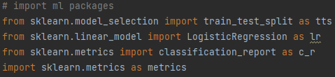
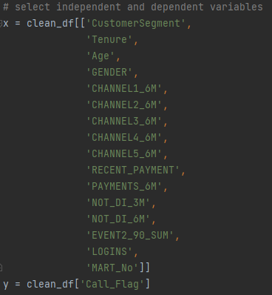
Machine Learning Method
As one who is relatively new to coding learning models, the more familiar sklearn packages were chosen to obtain the prediction model.
A total of 16 independent variables were selected to assist in predicting a possibility of a call, with identified results depicted in the Call_Flag column.

Slide 10
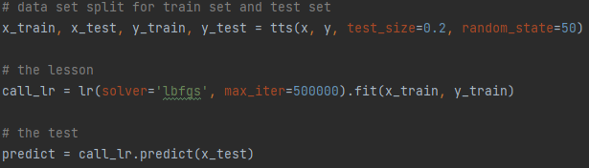
Further Machine Learning
The primary bulk of the learning was performed using logistic regression from sklearn with a randomized test size of 20%.

Slide 11
Evaluation
How functional is the model

Slide 12
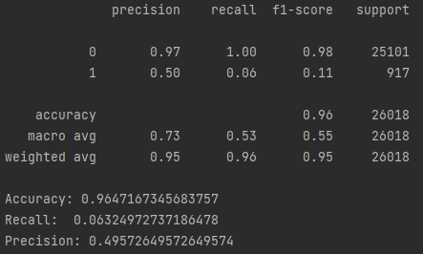
ML Report Card
An f1-score of 96% accuracy is acceptable for a beginner's attempt at creating a prediction model but would require more testing to consider it deliverable.

Slide 13
Take Away

Slide 14
Signing Off
Coding is impressive, and knowing what I can achieve with it is inspiring. I spent so much time researching what could be done that I am excited to see more.
This project still needs to be completed as I once again attempted more than I could handle by trying the extra undergrad credit. I hope to have time in the future to figure it out!

